Slide 1
Electrohub: Wired Autonomous Docking System for Electric Vehicles
Batch No. MHP40
Project Members
Priyanshu Ranka (RA2011018010033)
Keshav Bhardwaj (RA2011018010038)
Devyanshu Khare (RA2011018010052)
Under the Guidance of
Dr.Anitha Kumari
18MHP109L - Major Project

Slide 2
Introduction
Electrohub is a Autonomous Docking System for electric vehicles, revolutionizing charging infrastructure, enhancing user convenience, and promoting EV adoption.
It's advanced tech optimizes the process of charging for user convenience and efficiency.
It prioritizes efficient charging, reducing downtime for EV owners. Its integration with renewable energy sources promotes a greener and more sustainable approach.
It is scalable and compatible, easily integrating into existing charging infrastructure for widespread adoption in diverse urban landscapes.
18MHP109L - Major Project

Slide 3
Literature Review
S.No | Title of the Paper | Authors | Journal Name & year | Remarks
1 | 3D Vision Guided Robotic Charging Station for Electric and Plug-in Hybrid Vehicles | Justinas Miˇ seikis, Matthias R¨ uther, Bernhard Walzel, Mario Hirz and Helmut Brunner | Researchgate, March 2017 | KUKA LBR, ALanE, NRG-X, Markers are used, Camera setup, Halcon machine Vision Software, MoveIt Framework
2 | A review of robotic charging for electric vehicles | Hendri Maja Saputra,Nur Safwati Mohd Nor, Intan Zaurah Mat Darus, Edwar Yazid | International Journal of Intelligent Robotics and Applications, 30 October,2023 | Review on papers published between 2012 and 2022,
3 | Docking Method for Electric Vehicle Charging Terminal Using Monocular Camera | Donghee Noh, Seonhyeong Kim, Seojeong Kim, Kyoungho Choi, Donghoon Kim, Juhwan Choi, Keunho Park | International Journal of Intelligent Robotics and Applications, August 8th, 2023 | Square shaped landmark used(ArUco,16bits), Monocular camera and PPE Algorithm, Doosan Robotics A0912Model
18MHP109L - Major Project
Notes:
PPE - Plane based Pose Estimation Algorithm - 2 ways to solve it -- 1.Homography decomposition 2.PnP Problem

Slide 4
Literature Review
S.No | Title of the Paper | Authors | Journal Name & year | Remarks
4 | Research on Fast Identification and Location of Contour Features of Electric Vehicle Charging Port in Complex Scenes | Pengkun Quan, Ya’nan Lou, Haoyu Lin, Zhuo Liang, Shichun Di | IEEE Access, May21, 2023 | Hough Circle and Hough Line-Rough Positioning and QCS Method-Precise Positioning, Perspective-n-Point (PnP) Algorithm, Aubo-i10 RobotArm,
5 | AViTRoN: Advanced Vision Track Routing andNavigation for Autonomous Charging of Electric Vehicles | V. C. Mahaadevan, R. Narayanmoorthi, Sayantan Panda,Sankhadeep Dutta, Gerard Dooly | IEEE Access, 16 Jan 2024 | Using YOLOv8, IR Sensor and depth sensor within ROS framework, Hough Circle, KM Algorithm,
18MHP109L - Major Project
Notes:
PPE - Plane based Pose Estimation Algorithm - 2 ways to solve it -- 1.Homography decomposition 2.PnP Problem

Slide 5
Objective
Simulate the model in successfully docking and undocking of the charger.
Improve charging process precision, reducing downtime for EV owners and enhancing overall efficiency in the charging infrastructure.
Automate docking and undocking of the charger from the charging port with minimal intervention of the car owner.
18MHP109L - Major Project

Slide 6
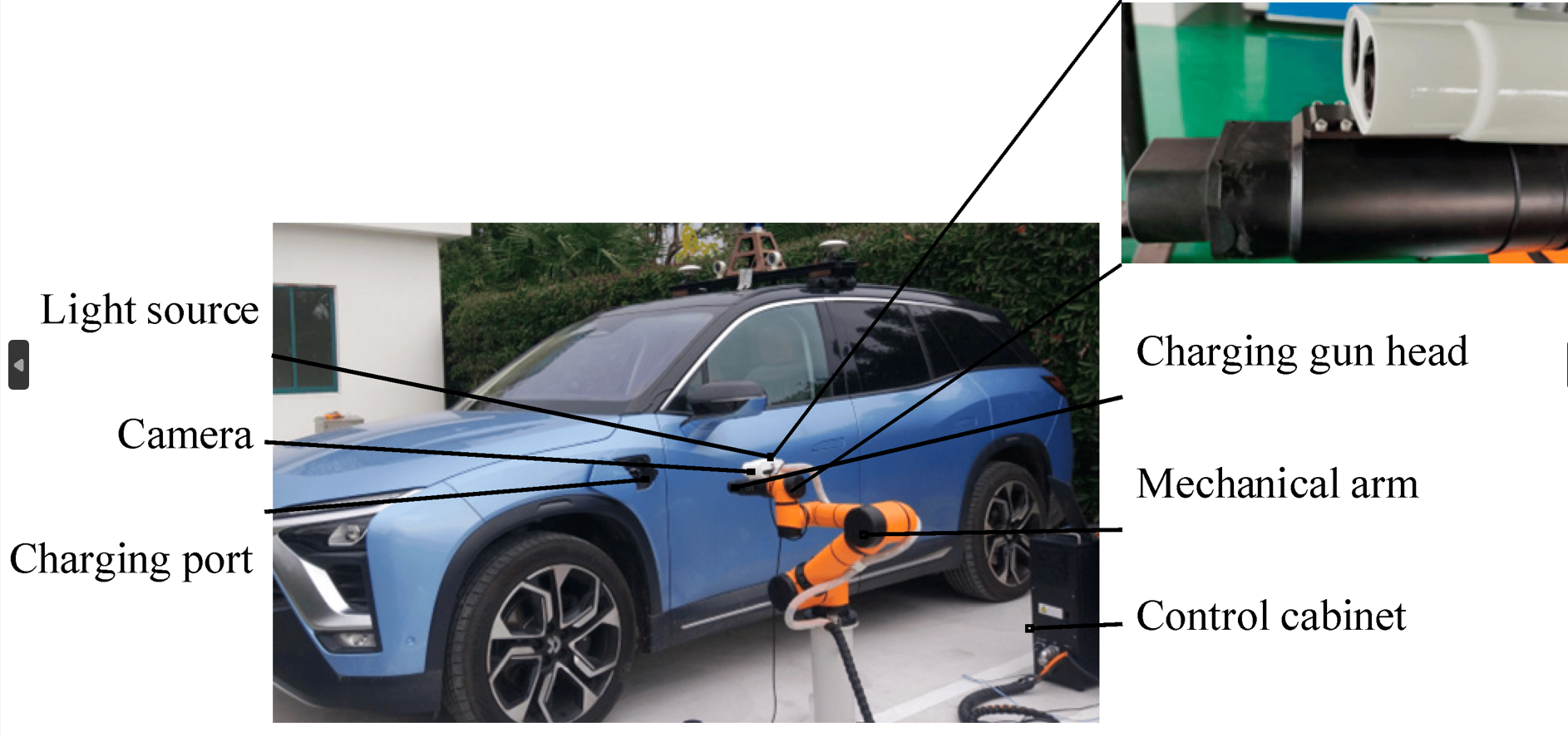
Proposed system
18MHP109L - Major Project

Slide 7
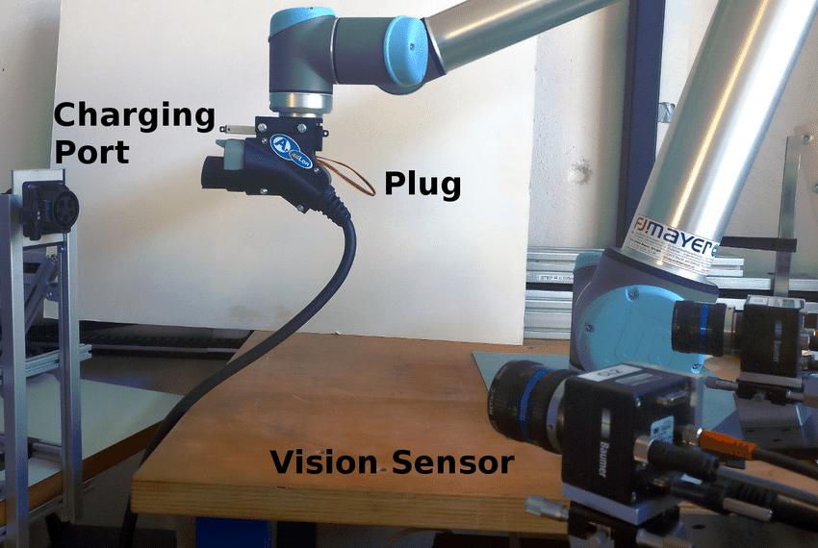
Reference Paper : 3D Vision Guided Robotic Charging Station for Electric and Plug-in Hybrid Vehicles

Slide 8
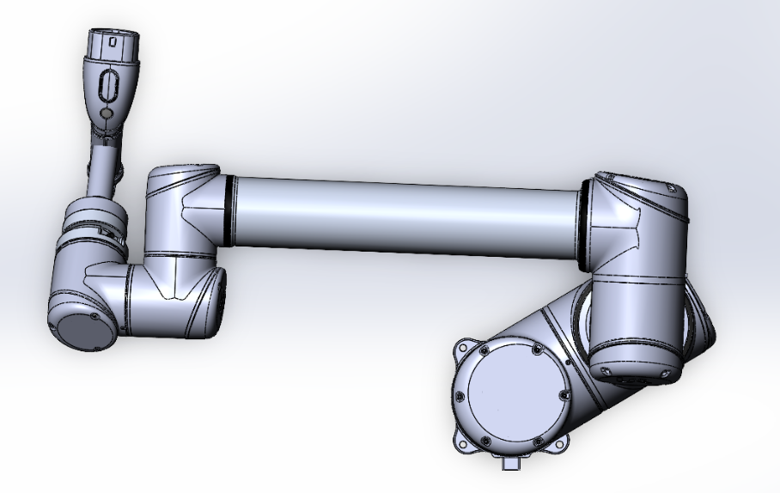
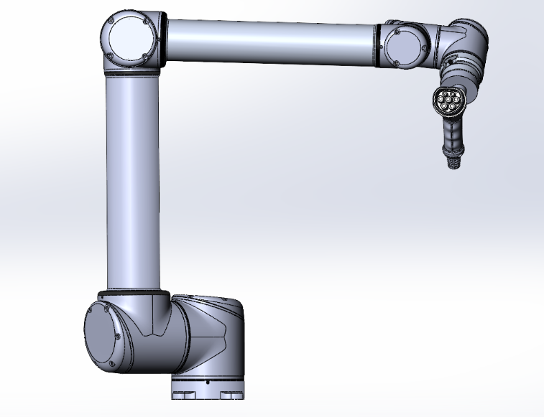
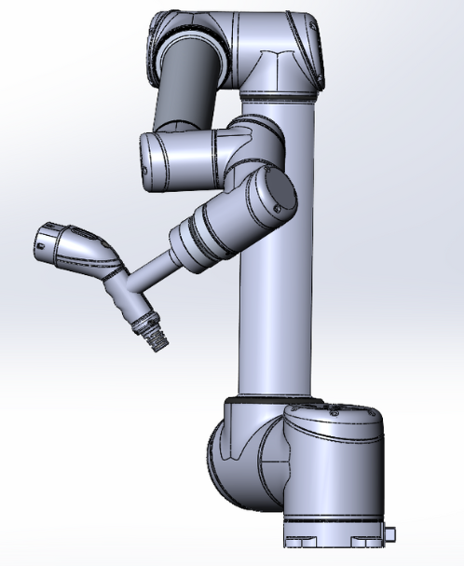
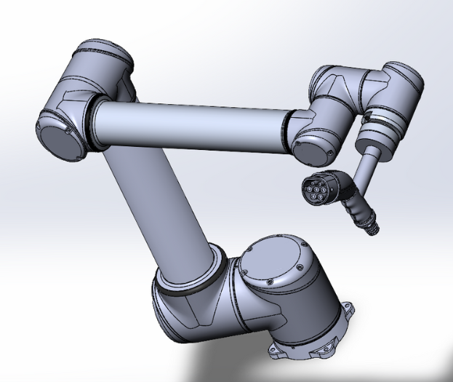
Base Design
Reach: 1.6M
Link 1: 75.41cm
Link 2: 70.35 cm
Joints: 7
D.O.F.: 6
Platform Height: 50 cm
Real life model scale: 1:6
18MHP109L - Major Project

Slide 9
Methodologies
Algorithm:
1. The car parks at the designated spot.
2. The camera detects the presence of the car.
3. Using OpenCV, the system identifies the model of the detected car.
4. The system determines the location of the electric port on the identified car.
5. The robotic arm is activated.
6. The robotic arm locates the electric port on the car.
7. The robotic arm connects the charger to the electric port.
8. The system initiates the charging process.
9. The system monitors the charging status.
10. If the charging is complete, the process ends; otherwise, the system continues monitoring until charging is complete.
18MHP109L - Major Project

Slide 10
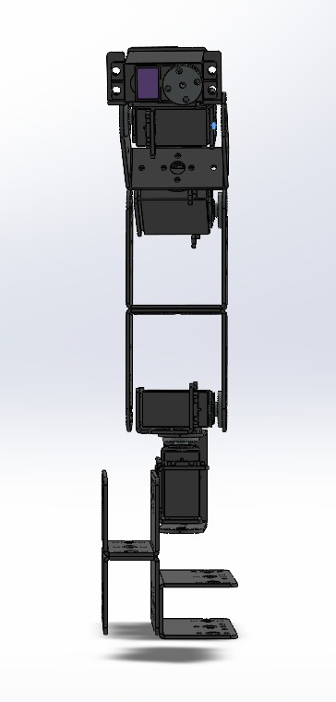
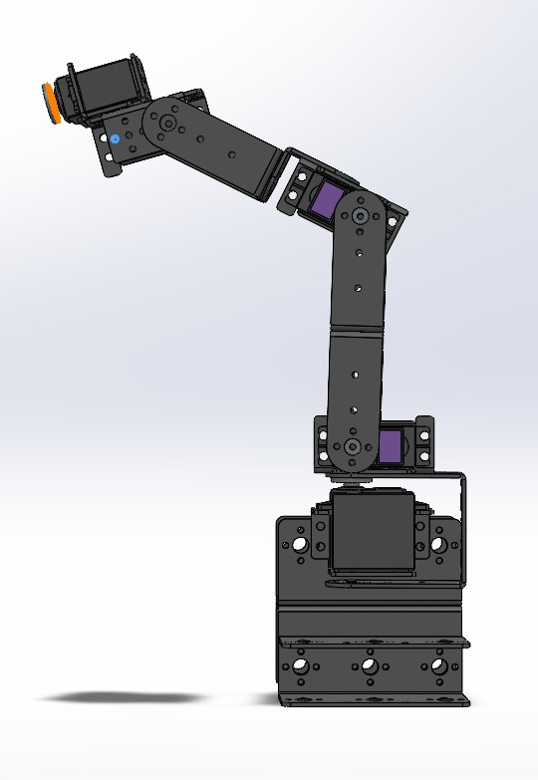
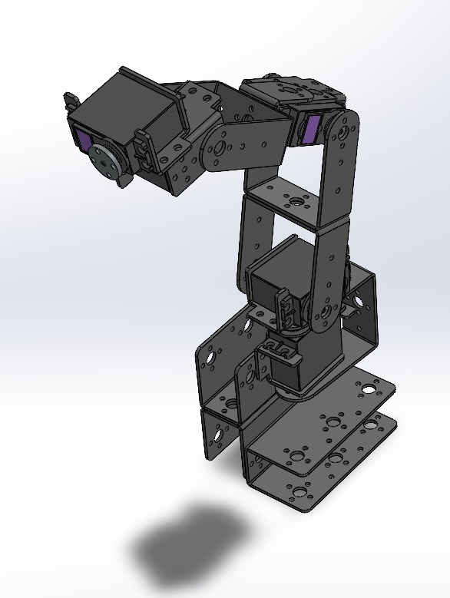
Progress
18MHP109L - Major Project

Slide 11
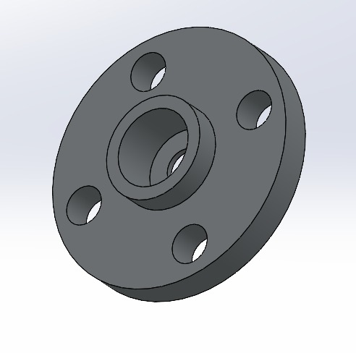
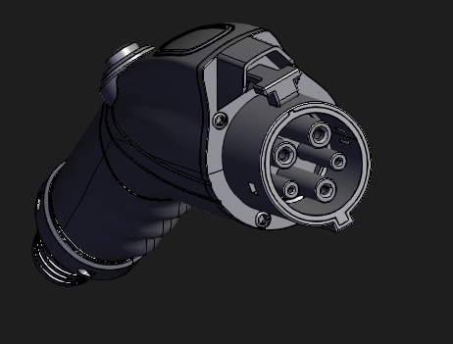
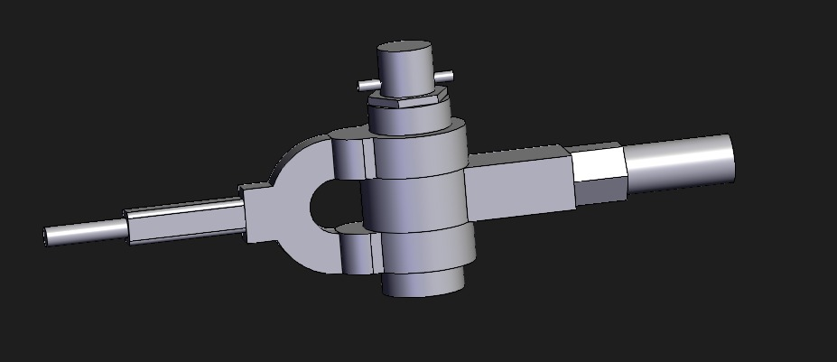
Progress (Yh page rakhna h ?)
18MHP109L - Major Project

Slide 12
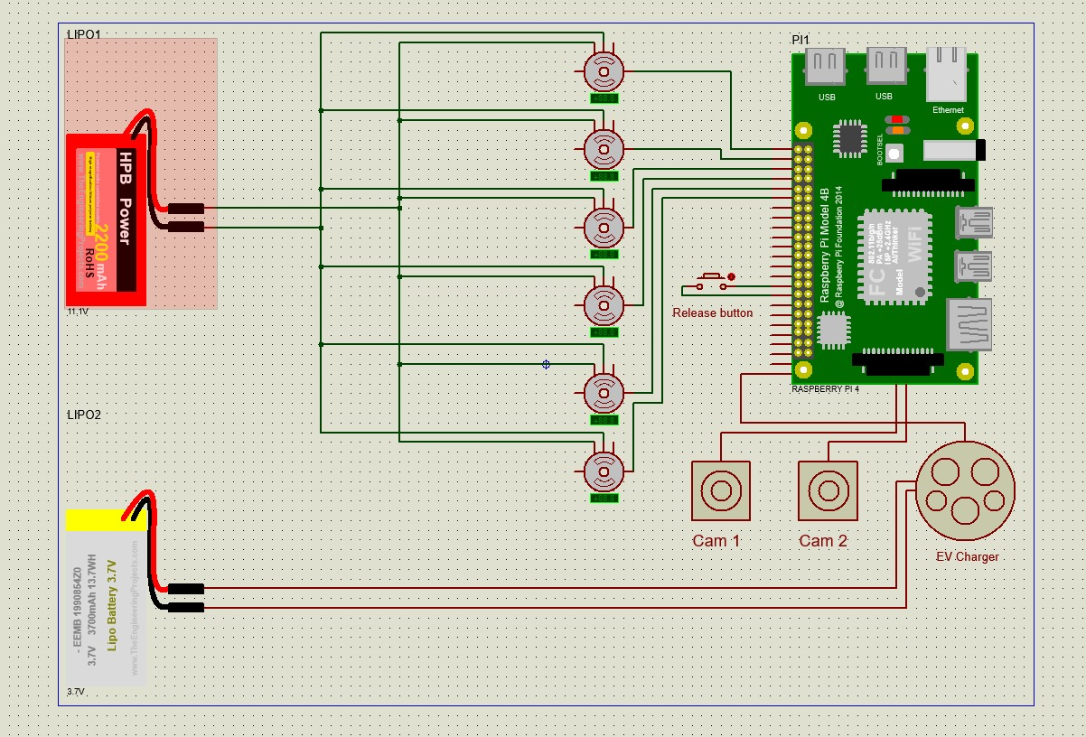
Progress
18MHP109L - Major Project

Slide 13
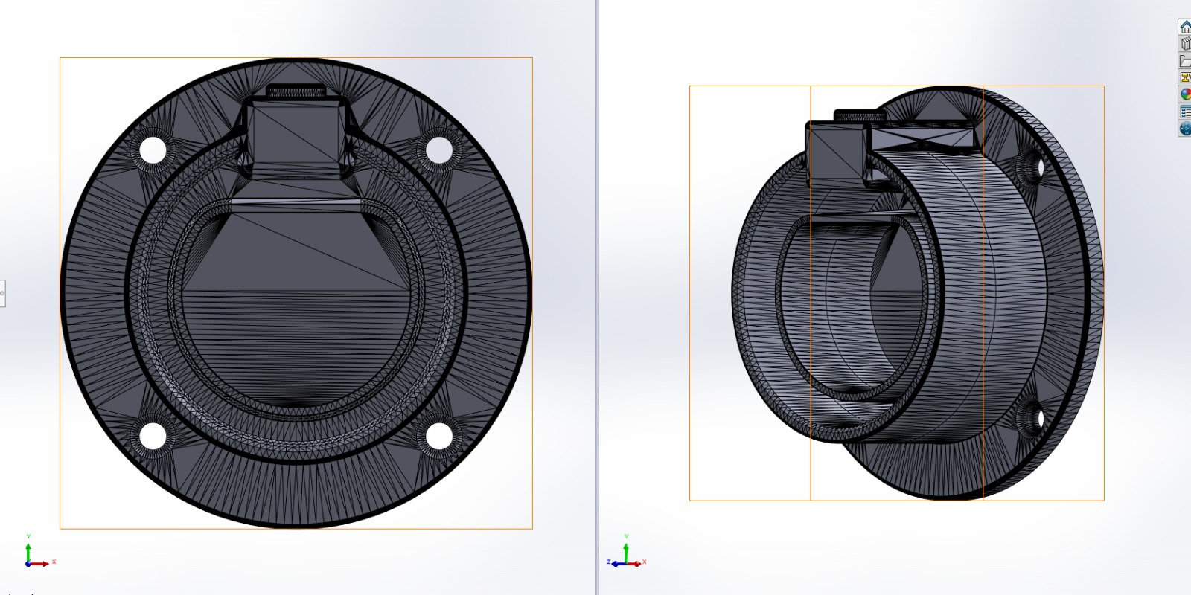

Slide 14
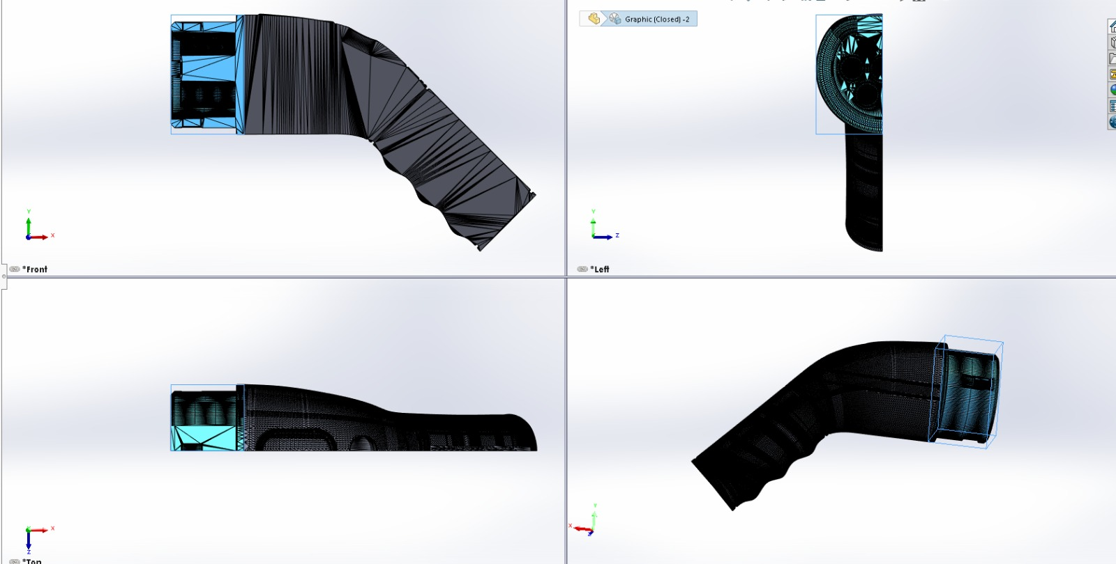

Slide 15
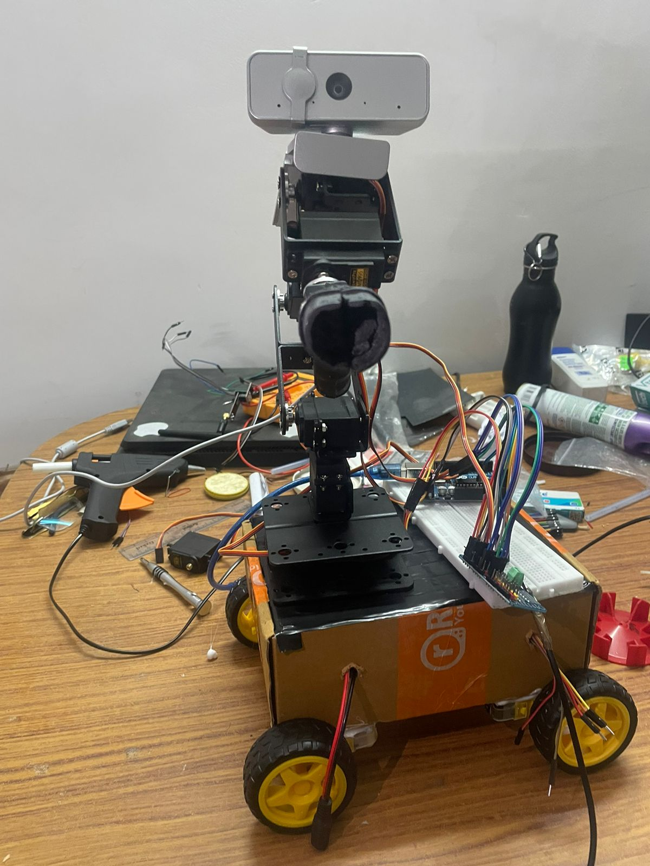
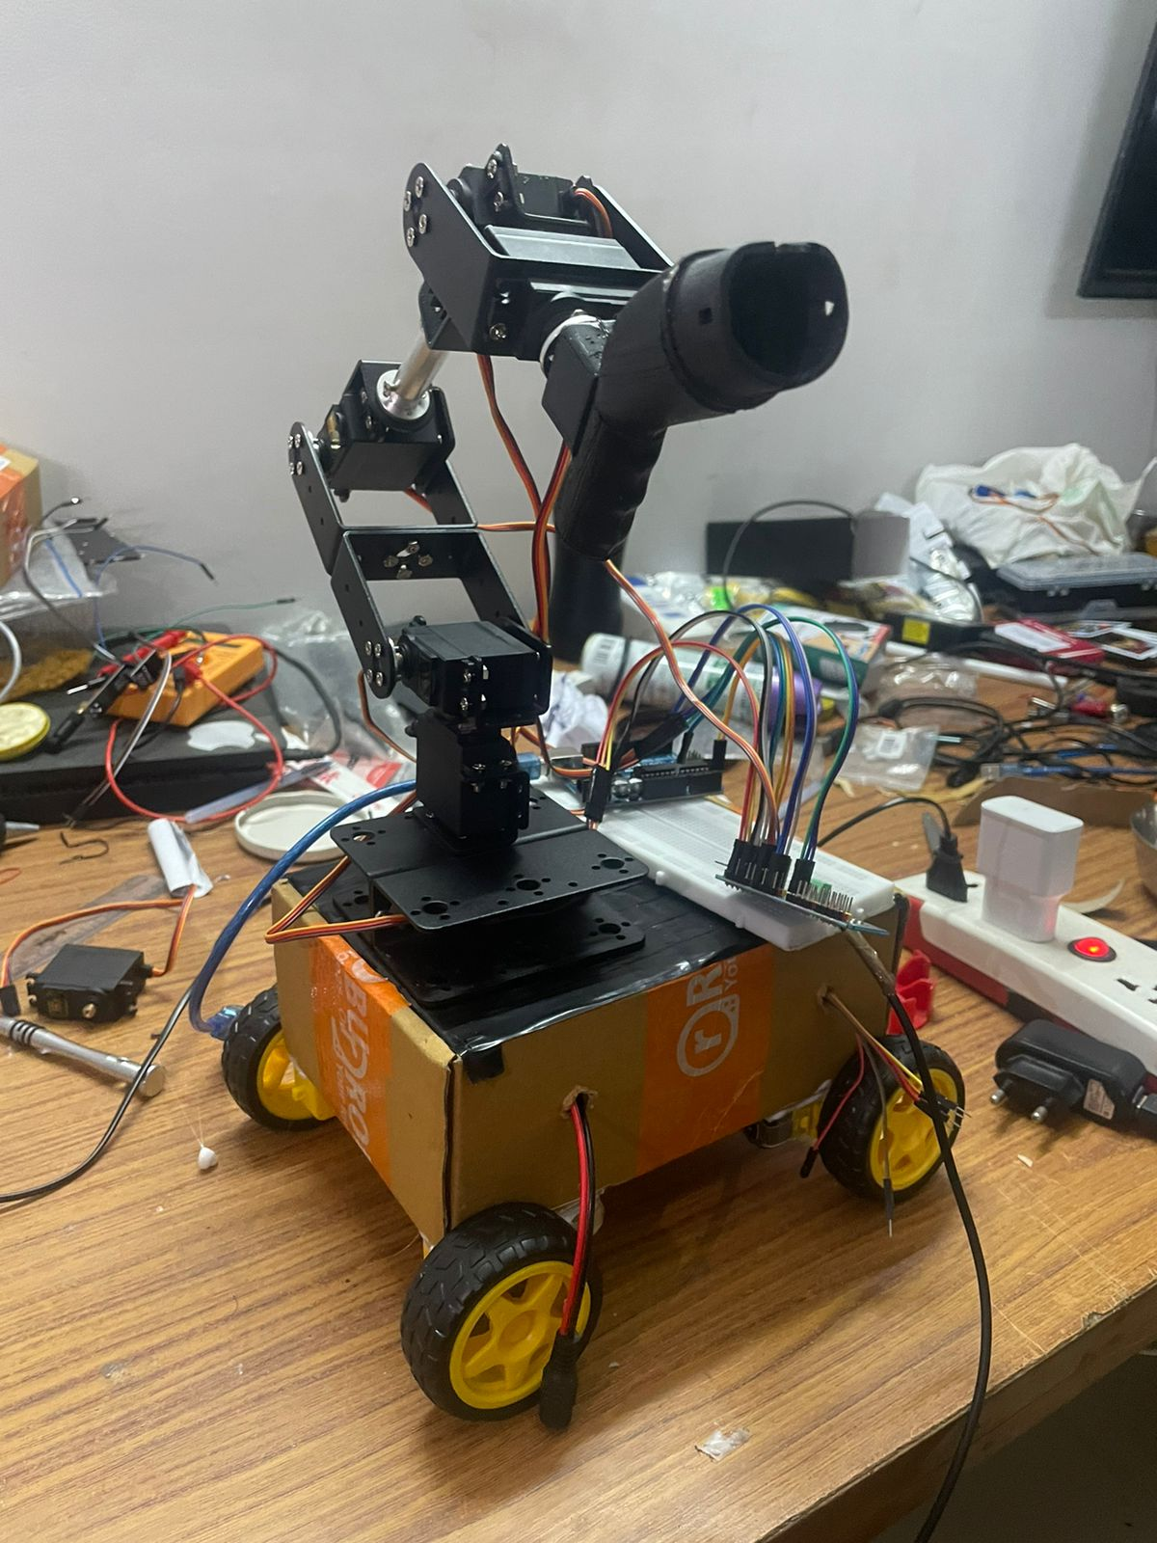

Slide 16
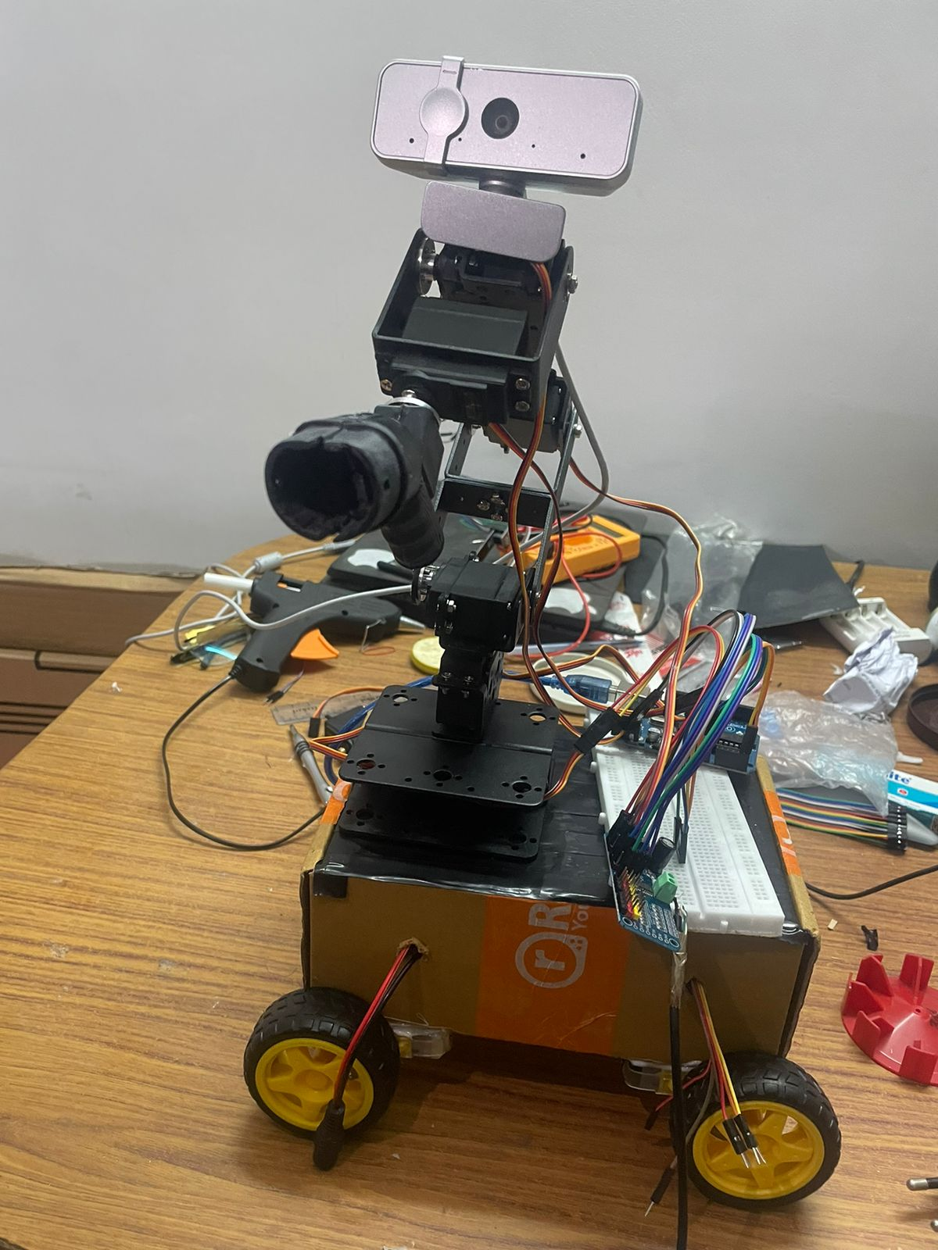
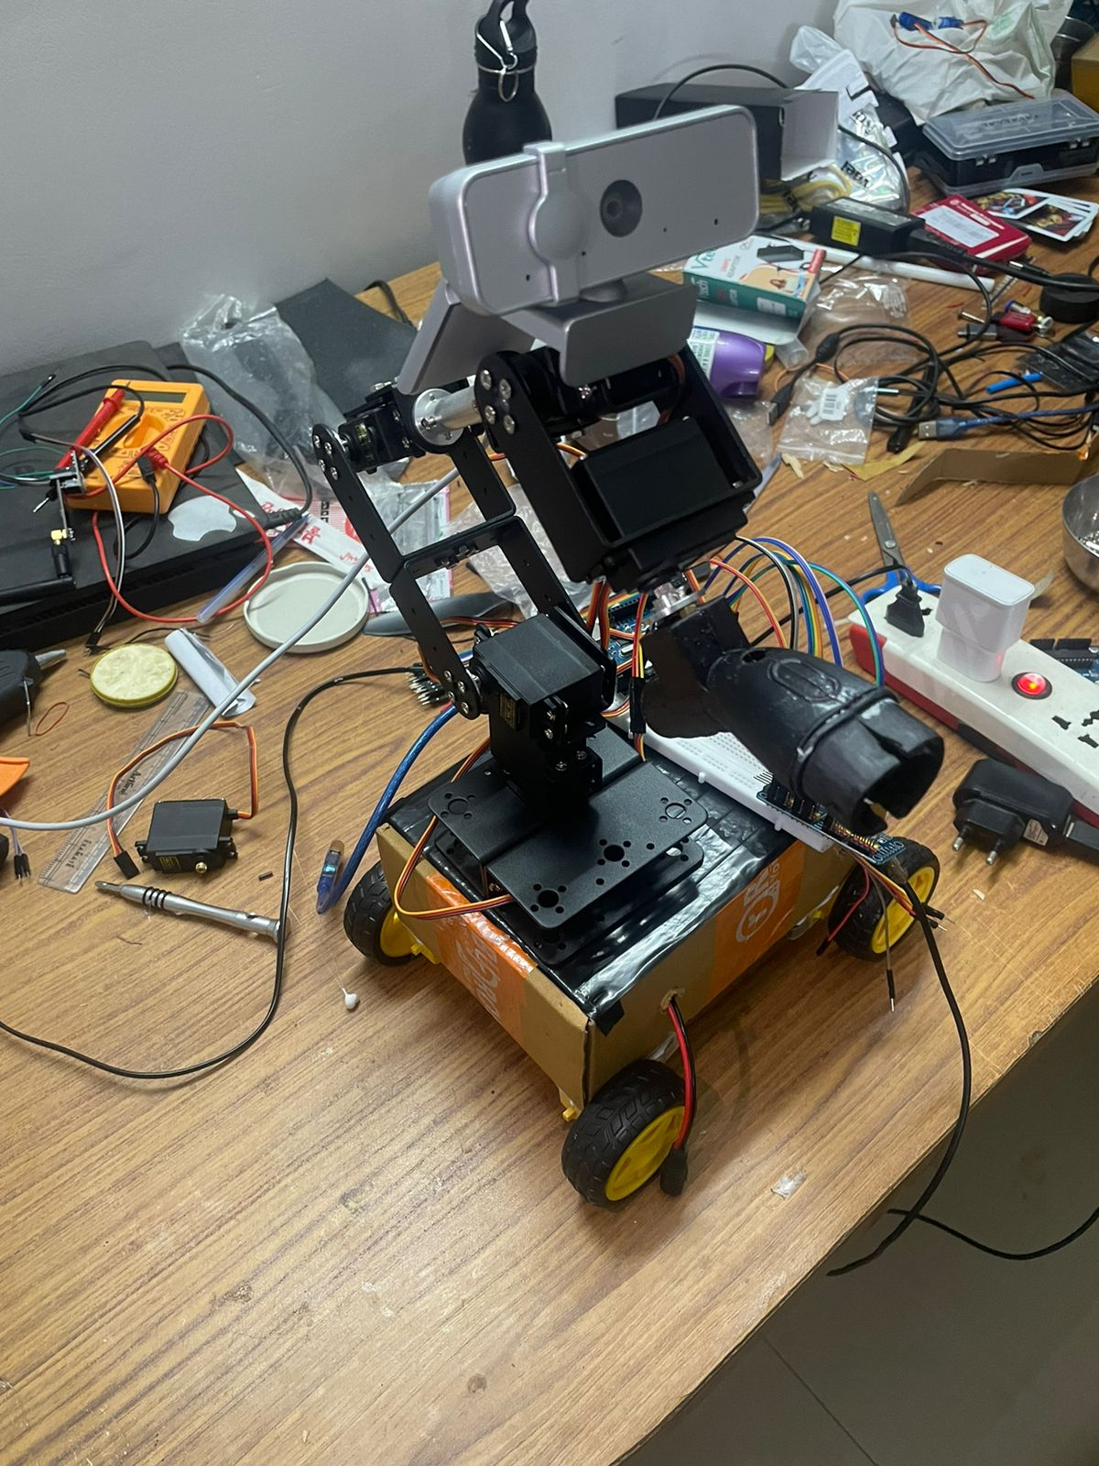

Slide 17

MACHINE LEARNING
Machine learning is a branch of artificial intelligence where computers learn from data patterns to make decisions or predictions without being explicitly programmed. It involves algorithms that iteratively improve their performance and uncover insights, enabling applications like speech recognition, recommendation systems, and autonomous vehicles.
Steps in ML training is depicted by the flowchart below.
Softwares Utilized
1. Teachable Machine:
Teachable Machine is a user-friendly web tool by Google that allows anyone to train machine learning models without coding. It simplifies the process of creating image, sound, or pose-based models for various applications.
2. Google Colab:
Google Colab, short for Colaboratory, is a free cloud-based platform provided by Google that allows users to write and execute Python code in a browser environment. It offers GPU and TPU support, facilitating collaborative coding and data analysis tasks.
3. LabelImg:
LabelImg is an open-source graphical image annotation tool used to label images for object detection tasks. It enables users to draw bounding boxes around objects and assign labels, generating annotations in various formats compatible with machine learning frameworks.

Slide 18
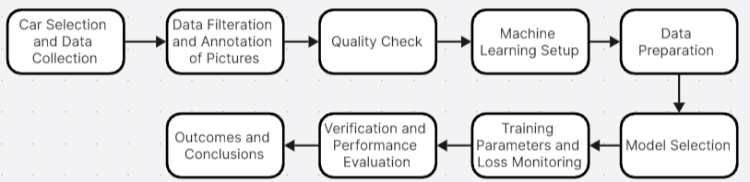
Iteration #1 : Using Google Colab and LabelImg
The steps involved in first iteration of Machine Leaning can be summarized with help of flowchart below.
Below table shows the total number of images annotated and used for the purpose of ML Training.
Car | Training (80%) | Validation (10%) | Testing (10%) | Total (1193 Images)
Hyundai Ioniq | 267 | 33 | 33 | 333
Tata Nano | 304 | 25 | 25 | 254
Tata Nexon | 201 | 25 | 25 | 251
Tata Tiago | 151 | 19 | 19 | 189
XUV 400 | 134 | 16 | 16 | 166

Slide 19
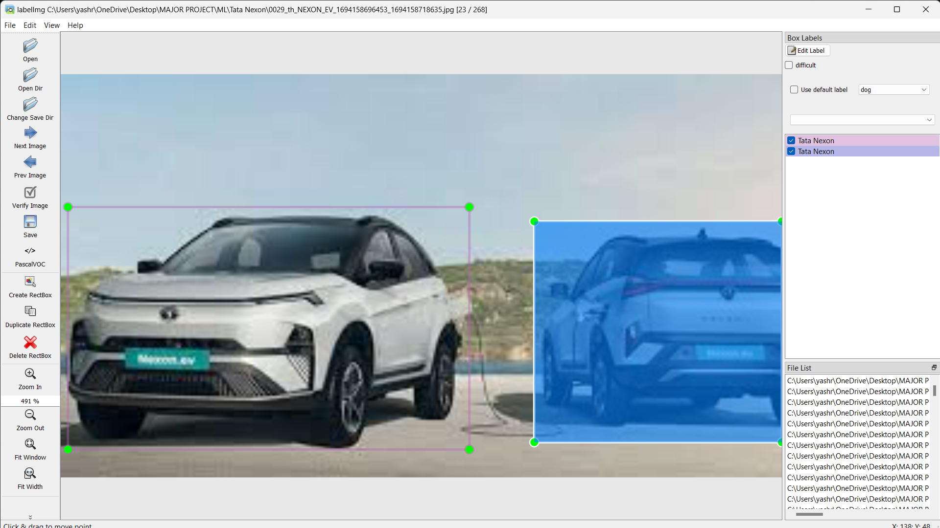
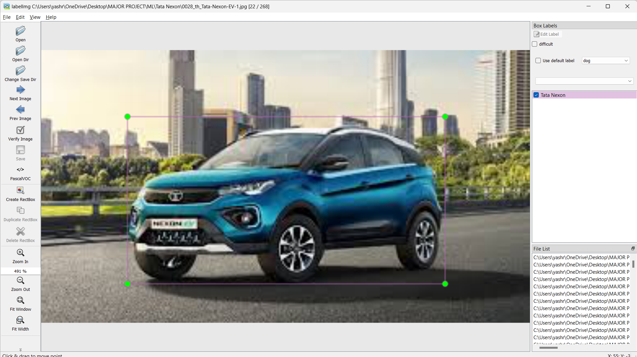
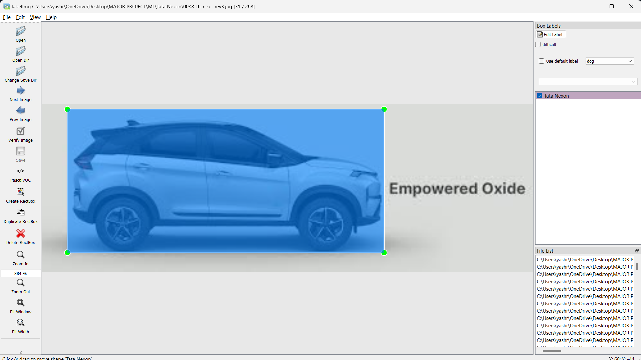
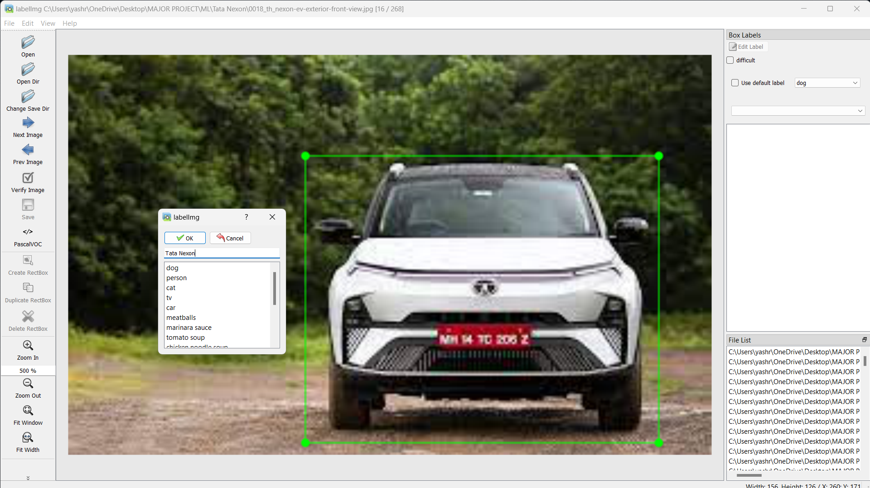
Annotation using LabelImg
18MHP109L - Major Project

Slide 20
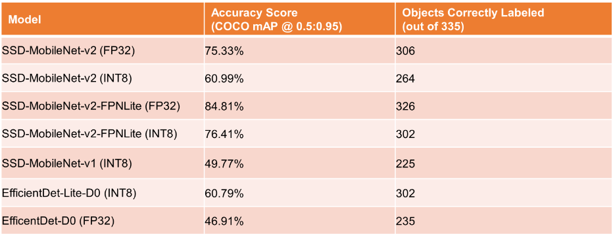
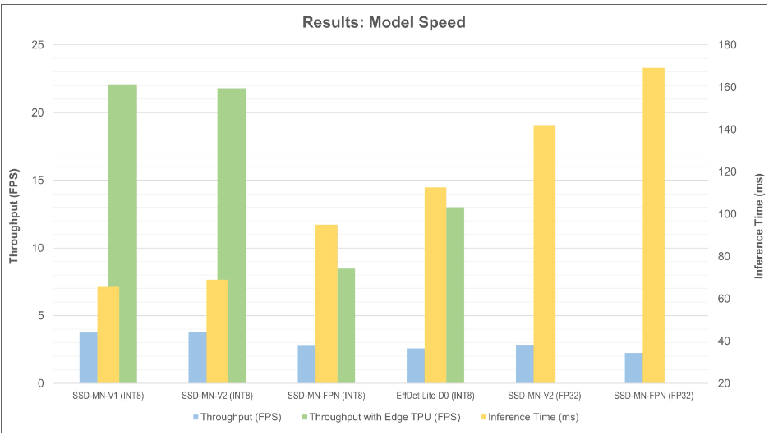
In machine learning training, Inference Time refers to the duration it takes for a trained model to process input data and produce predictions or outputs. It measures the speed at which the model can make predictions once it's deployed for inference of new data. On the other hand, Throughput or Frames Per Second (FPS) is a measure of the number of predictions or inferences a model can make in a given amount of time, typically measured in seconds. It represents the efficiency of the model in handling real-time data streams or processing large batches of data.
Selection of Model is based on below given comparison
18MHP109L - Major Project

Slide 21
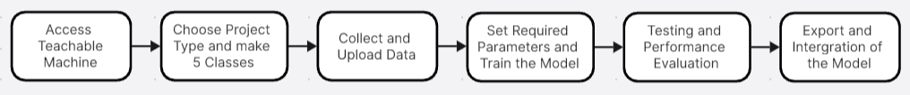
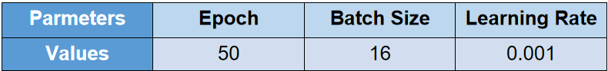
Iteration #2: Using Teachable Machine
The steps involved in this iteration of Machine Leaning can be summarized with help of flowchart below.
Link to Access our ML Model : https://teachablemachine.withgoogle.com/models/p-PDuUpUA/
The table below shows the parameters set for training the ML Model in this application.
Below Table shows the accuracy of ML Model.
Iteration No. | Sample Space | Correct Predictions | Incorrect Predictions | Accuracy (in %age)
1 | 10 | 10 | 0 | 100
2 | 10 | 9 | 1 | 90
3 | 10 | 8 | 2 | 80
4 | 10 | 10 | 0 | 100
5 | 10 | 9 | 1 | 90

Slide 22

ROS2
Open source software development kit for robotics applications.
Why ROS2?
1. Open-Source Ecosystem:
ROS 2 is an open-source robotics middleware framework, providing access to a vast ecosystem of libraries, tools, and community-developed packages.
2. Modular and Scalable Architecture:
ROS 2 offers a modular and scalable architecture that supports the development of complex robotics systems with ease.
3. Real-Time Capabilities:
ROS 2 includes real-time features and improvements over its predecessor (ROS 1), making it suitable for real-time and safety-critical applications in robotics.
4. Networking and Communication:
ROS 2 provides robust networking and communication capabilities, facilitating seamless communication between distributed robotic components and systems.

Slide 23
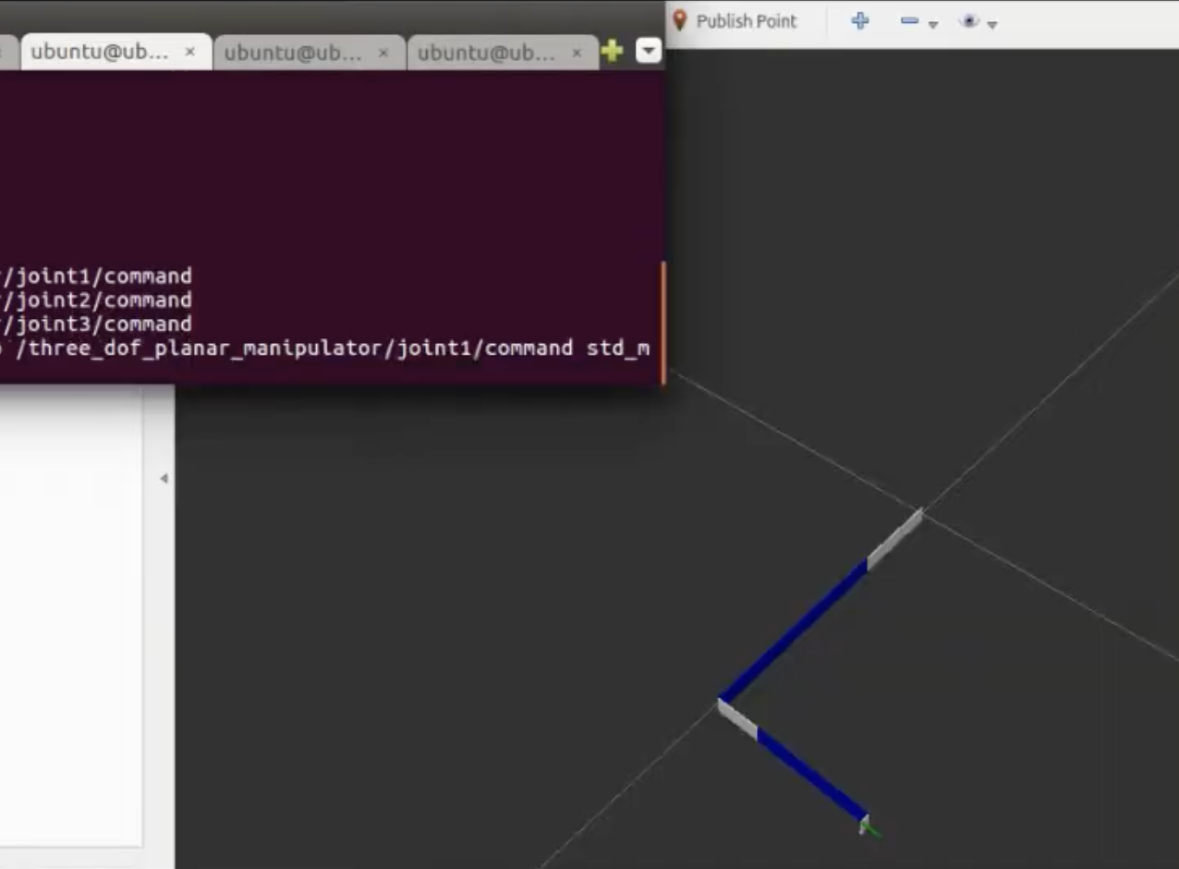
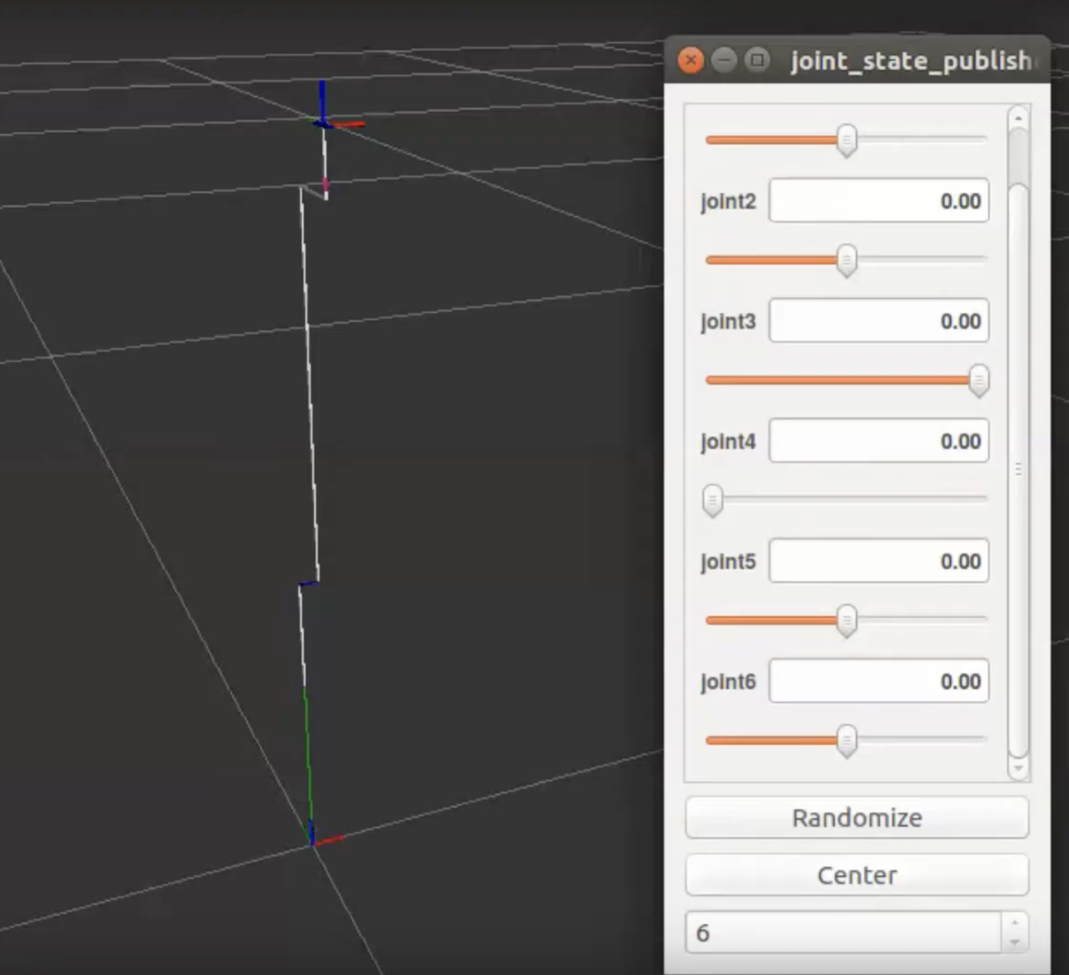
Objective Achieved:
Developed a skeleton structure urdf for a robotic arm.
Implement manual input interface for user interaction (joint state publisher GUI).
18MHP109L- Major Project

Slide 24
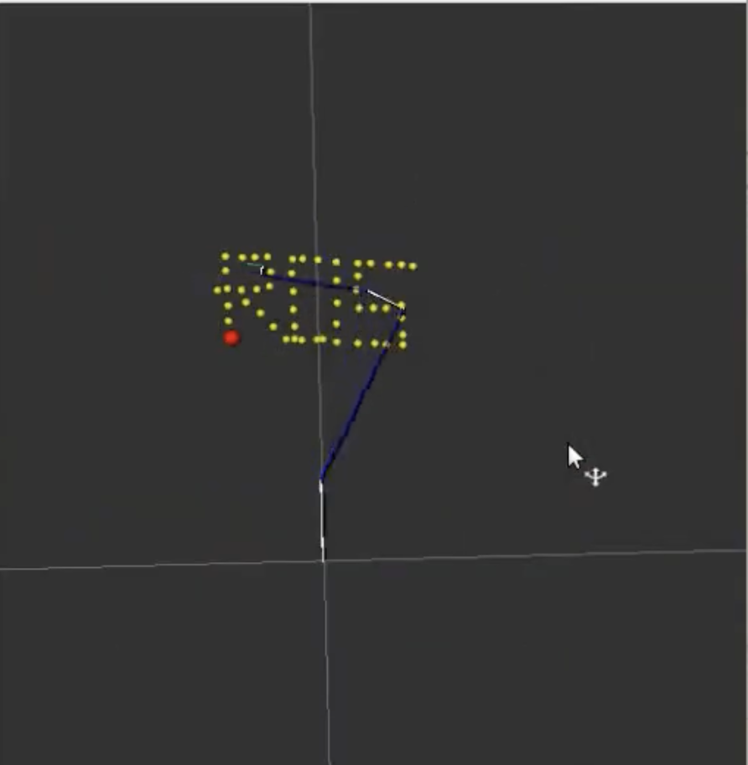
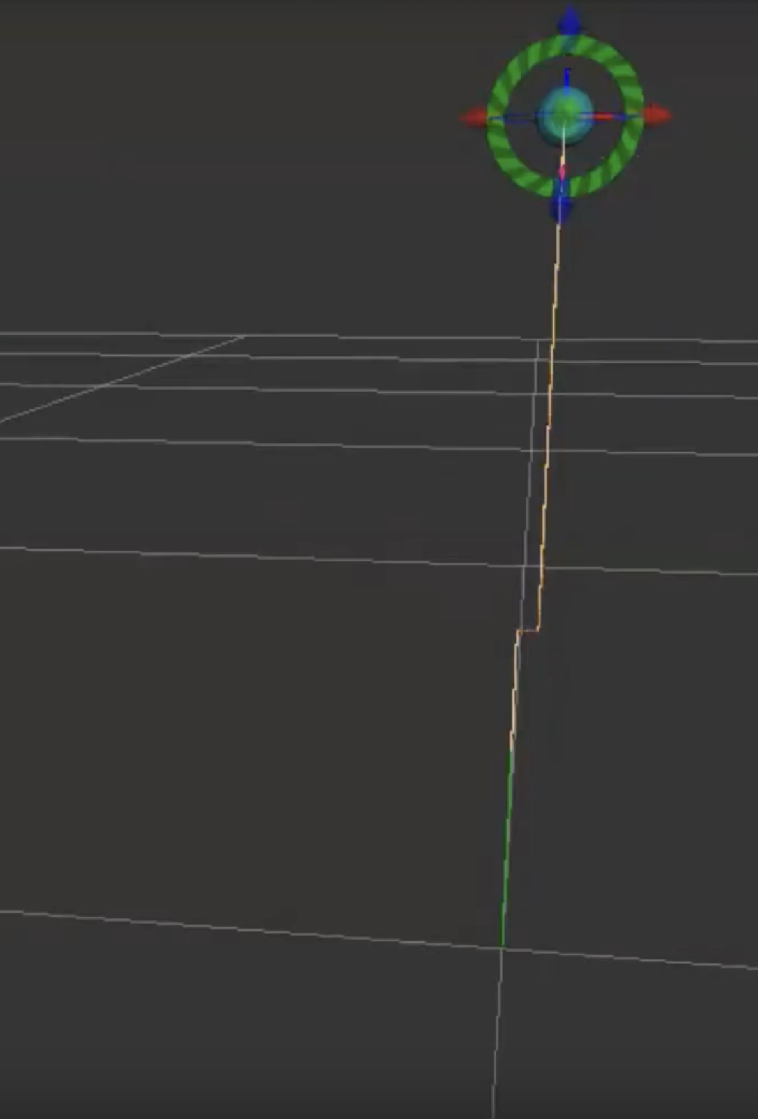
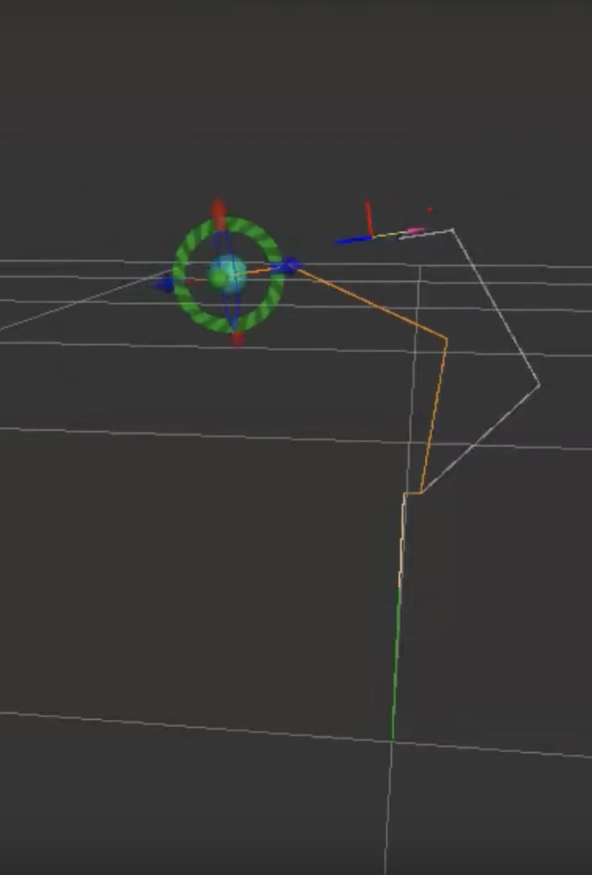
Objective Achieved:
Integrate Kinematics and Dynamics Library (KDL) for precise motion planning.
Incorporate pre-set paths or follow trajectory for efficient task execution.
18MHP109L- Major Project

Slide 25
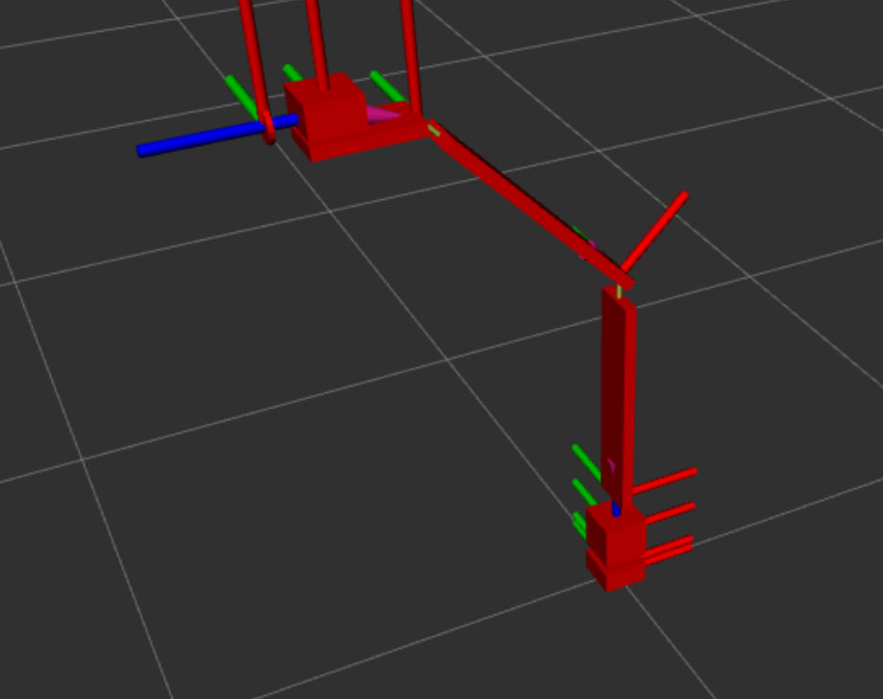
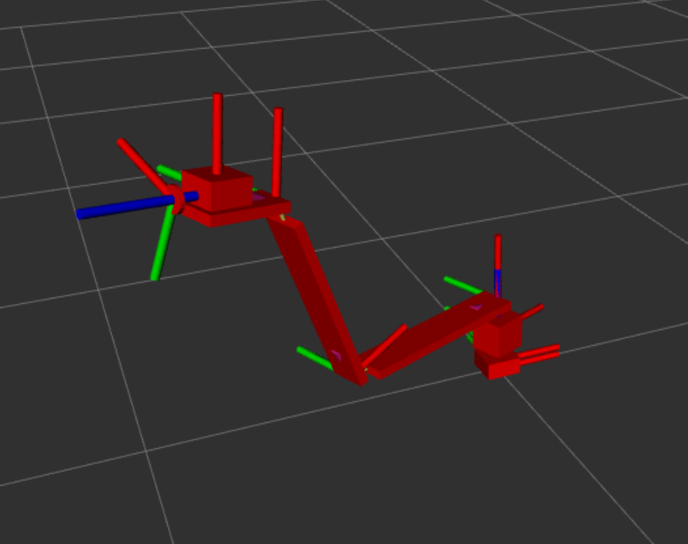
Custom URDF:
18MHP109L- Major Project

Slide 26
ROS & ROS2 Downfall:
Incompatibility to ARM64 microprocessor
Resource hungry
Complex Structure
Alternative Approach:
Build the system from Scratch
Using
Python
OpenCV
18MHP109L- Major Project

Slide 27
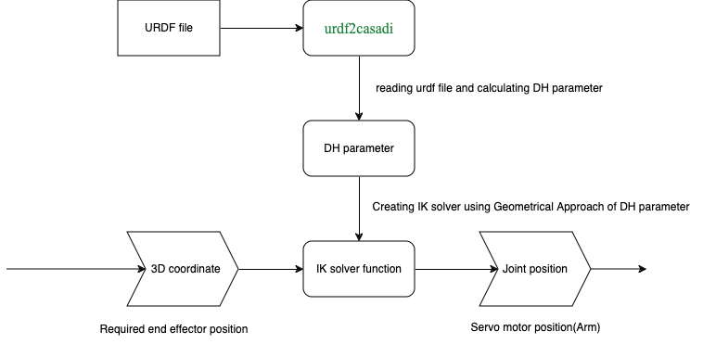
Inverse Kinematics Solver(using urdf2casadi):
18MHP109L- Major Project

Slide 28
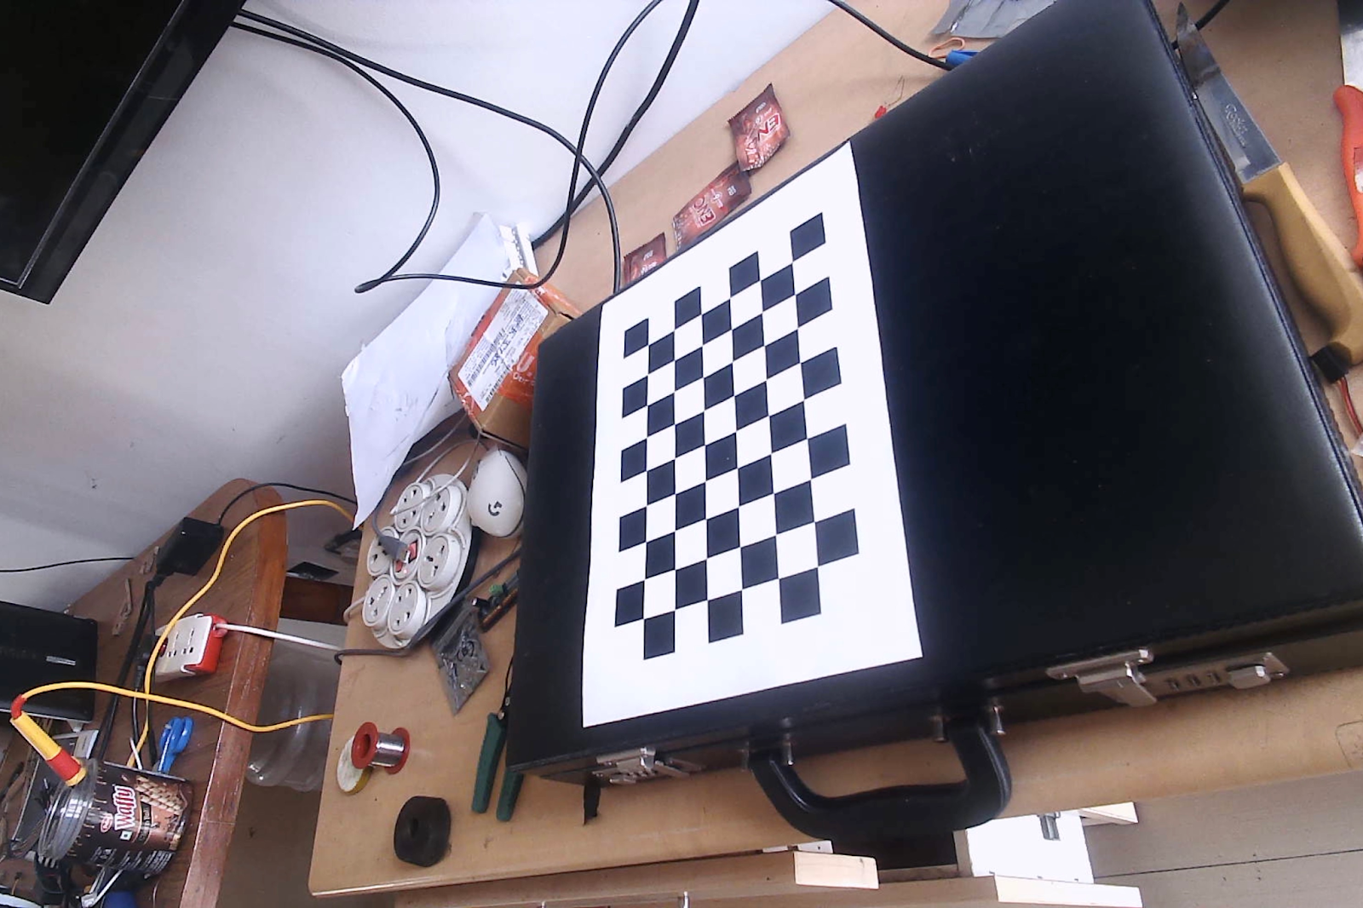
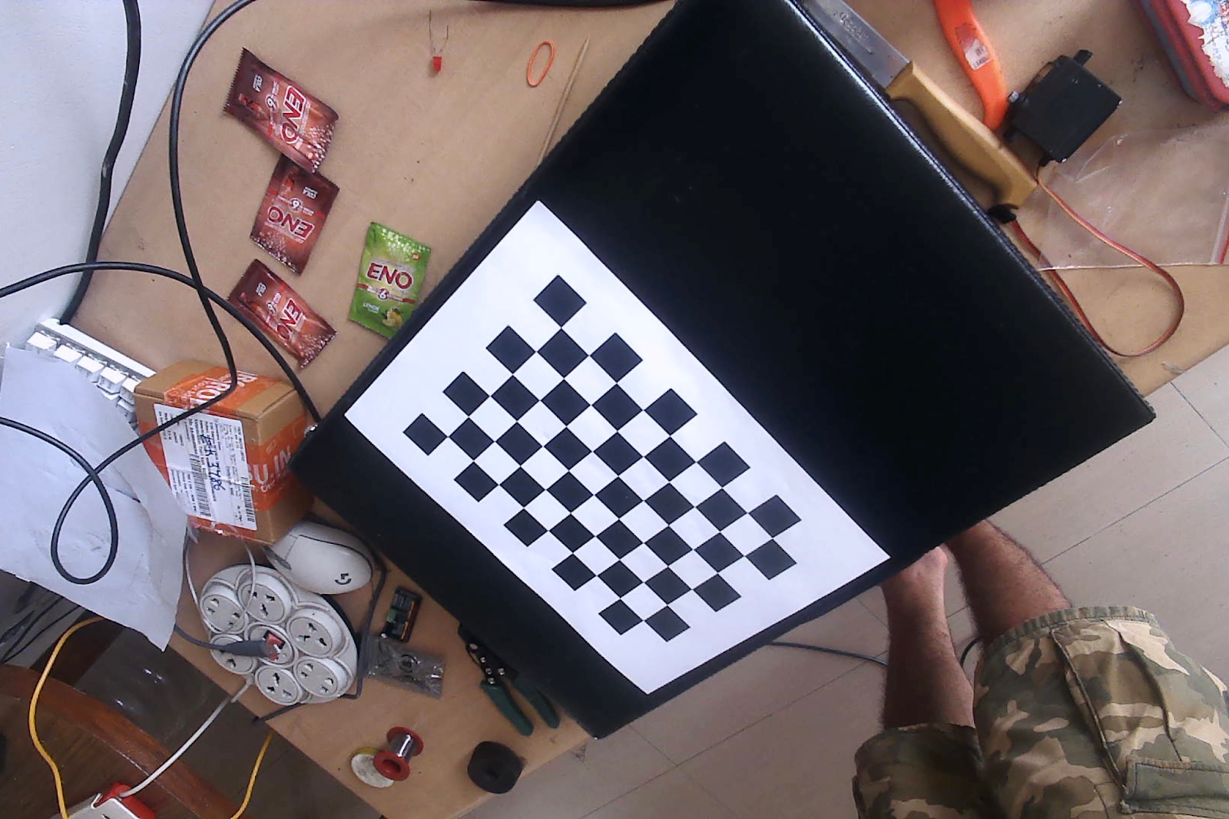
Camera Calibration:
Using OpenCV’s Camera calibration toolbox
Why chessboard?
Easier to recognise
Known dimensions
Known pattern
Steps for Camera Calibration:
Capturing Images
Corner detection
Calibration
Evaluation
Applications:
augmented reality
robotics
3D reconstruction
object tracking
18MHP109L- Major Project

Slide 29
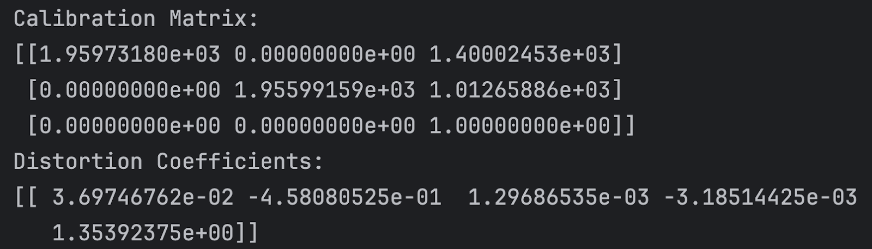
Calibration Matrix and Distortion Coefficients:
18MHP109L- Major Project

Slide 30
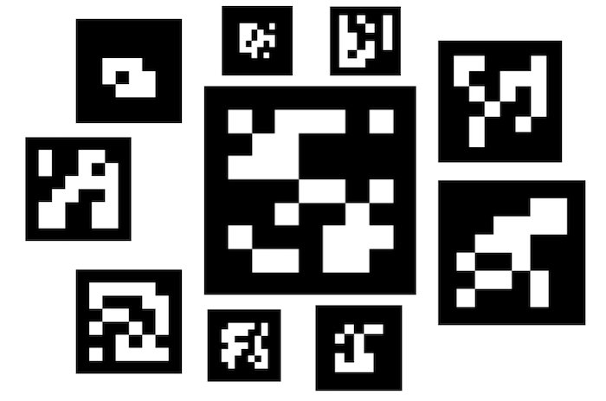
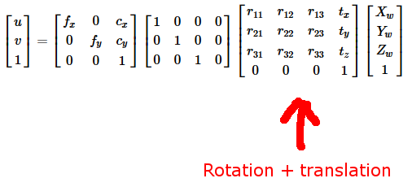
ArUco Marker:
augmented reality marker that are widely used in computer
vision and robotics application
Application used:
Pose Estimation
determining the position and orientation of a camera relative to
the marker
Data type:
Rotational vectors
Translation vectors
18MHP109L- Major Project

Slide 31
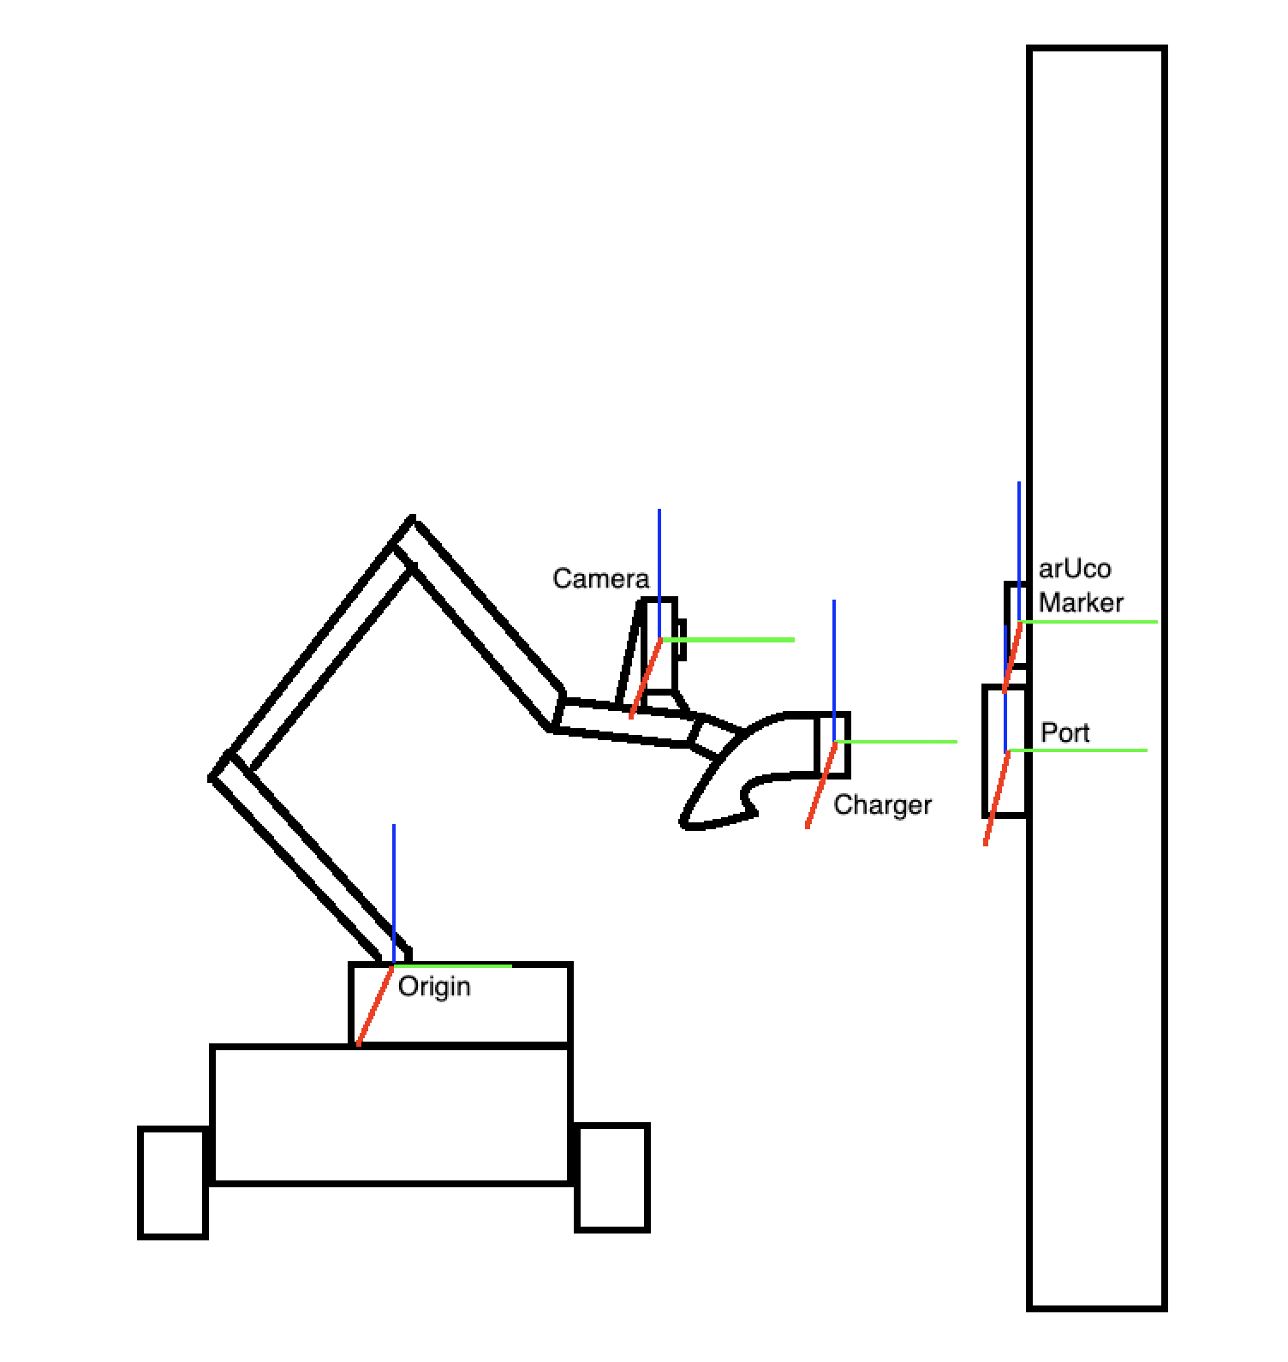
Toe x Tec x Tca x Tap = Top
Where,
Toe = Transformation from Origin to End Effector
Tec = Transformation from End Effector to Camera
Tca = Transformation from Camera to ArUco Marker
Tap = Transformation from ArUco Marker to Port
Top = Transformation from Origin to Port
18MHP109L- Major Project

Slide 32
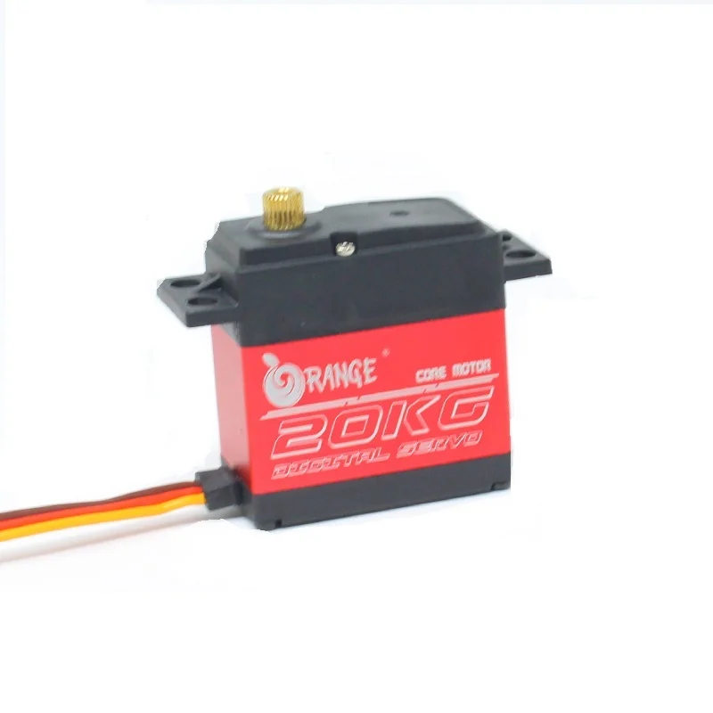
Discrepancy in Servo Positioning:
Physical range did not match logical range
30 to 150 degree -> Physical range
0 to 180 degree -> Logical range
Linear Expression Mapping:
mapped_angle = (angle - 30) * (180 / (150 - 30))
Impact on Project:
Proper functioning and accurate positioning
18MHP109L- Major Project

Slide 33
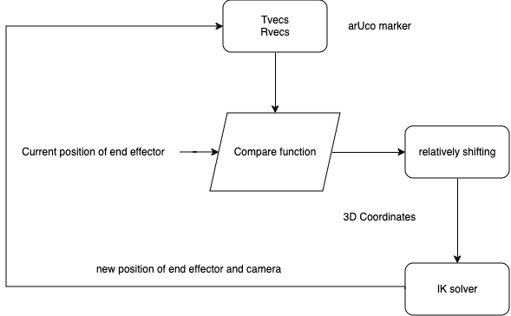
Relative positioning(better alternative):
18MHP109L- Major Project

Slide 34
Components required with Price details
S.No | Component Name | Specification | Price /piece (INR) | Quantity required | Total Cost (INR)
1 | Motor | 40KG Load | 1400 | 6 | 8400
2 | Raspberry Pi 4 | 8GB | 8000 | 1 | 8000
3 | 3d Printed parts | - | - | - | -
4 | Camera | 5mp | 750 | 1 | 750
5 | Cables | - | - | - | -
6 | Data Bus | (For camera) | - | - | -
7 | Heat Sink |  | 8 | 1 | 8
8 | Dual camera | IMX219-83 | 5900 | 1 | 5900
18MHP109L - Major Project

Slide 35
Work split up among the members
Devyanshu Khare : Design and Modelling of the whole system in CAD along with Embedded systems and circuit schemanics. 3D prinitng
Priyanshu Ranka : Vision system using OpenCv and positioning of the charger with resect to the charging port.
Keshav Bhardwaj : Control and feedback system using Ros2 and other required softwares.
The fabrication and assembly of the system shall be done by all members. Algorithms to be done by Keshav and Priyanshu depending upon the compatibility of the softwares to be intergrated together.
18MHP109L - Major Project

Slide 36
Expected outcome
By the end of the project, we would’ve achieved the following
Simulation of proposed model ie Electrohub.
Design and fabrication of the autonomous charging system for Electric Vehicle.
Analyzing results of the robot system model for charging application to get minimum of 80-85% accuracy
18MHP109L - Major Project

Slide 37
References
Miseikis, Justinas & Rüther, Matthias & Walzel, Bernhard & Hirz, Mario & Brunner, Helmut. (2017). 3D Vision Guided Robotic Charging Station for Electric and Plug-in Hybrid Vehicles.
Saputra, H.M., Nor, N.S.M., Rijanto, E. et al. A review of robotic charging for electric vehicles. Int J Intell Robot Appl (2023). https://doi.org/10.1007/s41315-023-00306-x
Donghee Noh, Seonhyeong Kim, Seojeong Kim et al. Docking Method for Electric Vehicle Charging Terminal Using Monocular Camera, 08 August 2023, PREPRINT (Version 1) available at Research Square [https://doi.org/10.21203/rs.3.rs-3180077/v1]
P. Quan, Y. Lou, H. Lin, Z. Liang and S. Di, "Research on Fast Identification and Location of Contour Features of Electric Vehicle Charging Port in Complex Scenes," in IEEE Access, vol. 10, pp. 26702-26714, 2022, doi: 10.1109/ACCESS.2021.3092210.
V. C. Mahaadevan, R. Narayanamoorthi, S. Panda, S. Dutta and G. Dooly, "AViTRoN: Advanced Vision Track Routing and Navigation for Autonomous Charging of Electric Vehicles," in IEEE Access, vol. 12, pp. 12402-12423, 2024, doi: 10.1109/ACCESS.2024.3355018.
18MHP109L - Major Project

Slide 38
Thank You
18MHP109L - Major Project

